Slide 1
Bike Riding Style Classification
DATA 5100, Image Classification Project
By: Alyssa Zukas

Slide 2
Agenda
Preparation
Introduction
EDA
Purpose
Analytical Approach
Libraries
Timeline of Analysis
Data Collection
Data Preparation
Data Block Overview
Example Images
Modeling
Evaluation
Epochs Parameters
Confusion Matrix
Deployment
Final Evaluation

Slide 3
Introduction
Purpose
Domain Problem
Analytic Approach

Slide 4
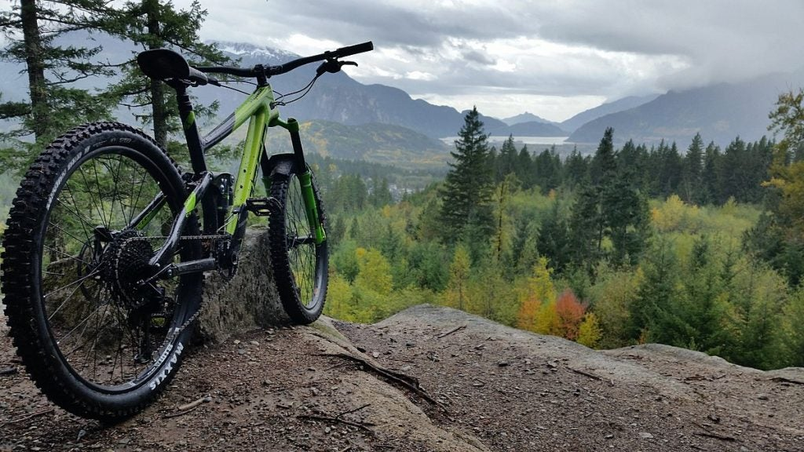
Introduction
Domain Problem
We want to develop a model to classify a bike based off of what it can see an image, into one of the following riding styles: Cross Country, Downhill, Enduro, Trail or Dirt Jumper.
Notes:
The purpose of the assignment is to perform work using the FastAI library and transfer learning to train a deep neural network to perform image classification using a data set from Kaggle.
My Initial Domain Problem involved a 2-level classification system - first starting off with the model classifying the “bike type” in an image.. And then classifying the riding style further from there.
What was discovered in my analysis process later lead me to change this domain problem to what you see on the screen…. Training the model to classify mountain bikes into one of the following riding styles: Cross Country, Downhill, Enduro, Trail or Dirt Jumper.
We will talk on this change later in the Evaluation portion of this presentation… but for now, we will walk through the process from start to finish as if the 2nd Domain Problem was the intention all a long.

Slide 5
Libraries
Kagglehub: For downloading datasets directly from Kaggle into Google Colab.
Json: For parsing and processing structured data from JSON files.
Pandas: For cleaning, merging, and manipulating tabular data.
Matplotlib.pyplot: For creating static visualizations and plotting model results.
Seaborn: For statistical data visualization and probability plots.
Os: For file and directory operations.
Requests: For retrieving and downloading image data from URLs.
Tqdm: For displaying progress bars during data download and preprocessing loops.
FastAI: For training and testing the model - mainly the vision_learner and Classification Interpretation features
Notes:
This project utilizes about 9 python libraries and packages with can be further explained in our Analysis Notebook.
The goal is for the model to learn the underlying relationship between the inputs and outputs so that it can make accurate predictions on new, unseen data.
We will use a lot of the libraries as in previous projects, but some new ones to emphasize here is the FastAI library – specifically the visioer_learner and Classification Interpretatio… which we will use to train and test the model.

Slide 6
Deploy the model, analyze the predictions, and evaluate performance
Establish Domain Problem & Set Up GPU for Project
Examine example images from our data set.
Introduction
Preparation
EDA
Modeling
Evaluation
Data Collection & Data Preparation
Build and train the classification system
Notes:
Here you can see a timeline of our analysis process…starting off with how we set up the project and the initial analysis of the data we imported from kaggle , all the way to the deployment of the model and evaluation of the models predictions and overall performance.
In this presentation we will be leaving out the steps taken to set-up the project, but these details can be viewed in the google collab notebook used for the analysis of this project.
Since we will use labeled images of various bike categories to train a classifier how to predict bike types... we will be taking a predictive approach throughout this analysis.

Slide 7
Preparation
Data Collection
Data Preparation

Slide 8
Data Collection
Bike Ads (images, prices, specifications)
10,052 bicycle advertisements from June 2020.
4 main data folders
combined_price-only.csv
data_bike_exchange.json
data_ebay.json
images
Notes:
This project utilizes one Kaggle folder downloaded from the website.
Bike Ads (images, prices, specifications)
This data folder contains information from 10,052 bicycle advertisements in June 2020. Such as the ad title, main image, condition, and specification details (brand, color, frame, size, etc.) of the bike in the images.
This information was distributed across 4 different data files, each containing different information we want to use to classify bike riding styles..which are displayed on the screen.
We will obviously be using the images file, but part of the data collection process was to go through each file and view the attributes of each to verify that it contained the necessary information we need to train out model — after doing this initial analysis I decided to use the specification details in the JSON file from the Bike Exchange data to help us train the model to predict riding styles of the bikes in the images we also downloaded …
This decision was made based off many detected missing values in the ebay JSON file… while the Bike Exchange file contained 889 entries that already contained 3 bike types and 7 riding styles.
Although pricing does differ across bike types… this does really apply to the point of interest for this project, so I chose to leave this detail out.
The dataset is available for commercial/research purposes under a Creative Commons Corporation - CC0 1.0 Universal License. There is no copyright for this data.

Slide 9
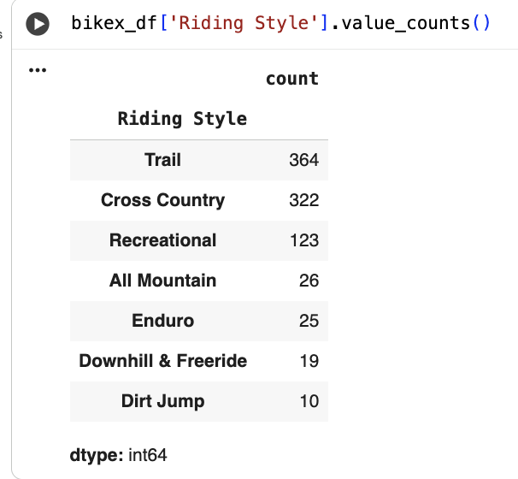
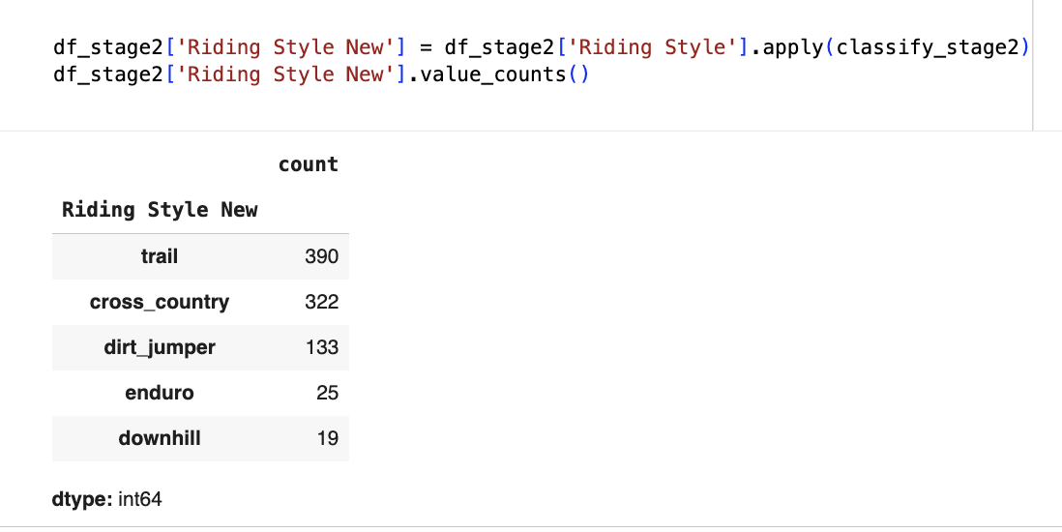
Data Preparation: Riding Style Classification
Original Riding Styles
New Riding Styles
Notes:
After importing the necessary files from the folder downloaded on Kaggle AND performing the initial analysis on the data files…
We then converted the Bike Exchange JSON files into data frame so that we could change column names and edit the 7 original bike classification labels.
On the left of the screen you can see the original riding style categories that were already in the file..
And on the right, you can you see the new categories we created by changing the names and combining the Trail & All Mountain Categories and Recreational & Dirt Jumper Categories.

Slide 10
Exploratory Data Analysis
Data Block Overview
Example Images

Slide 11
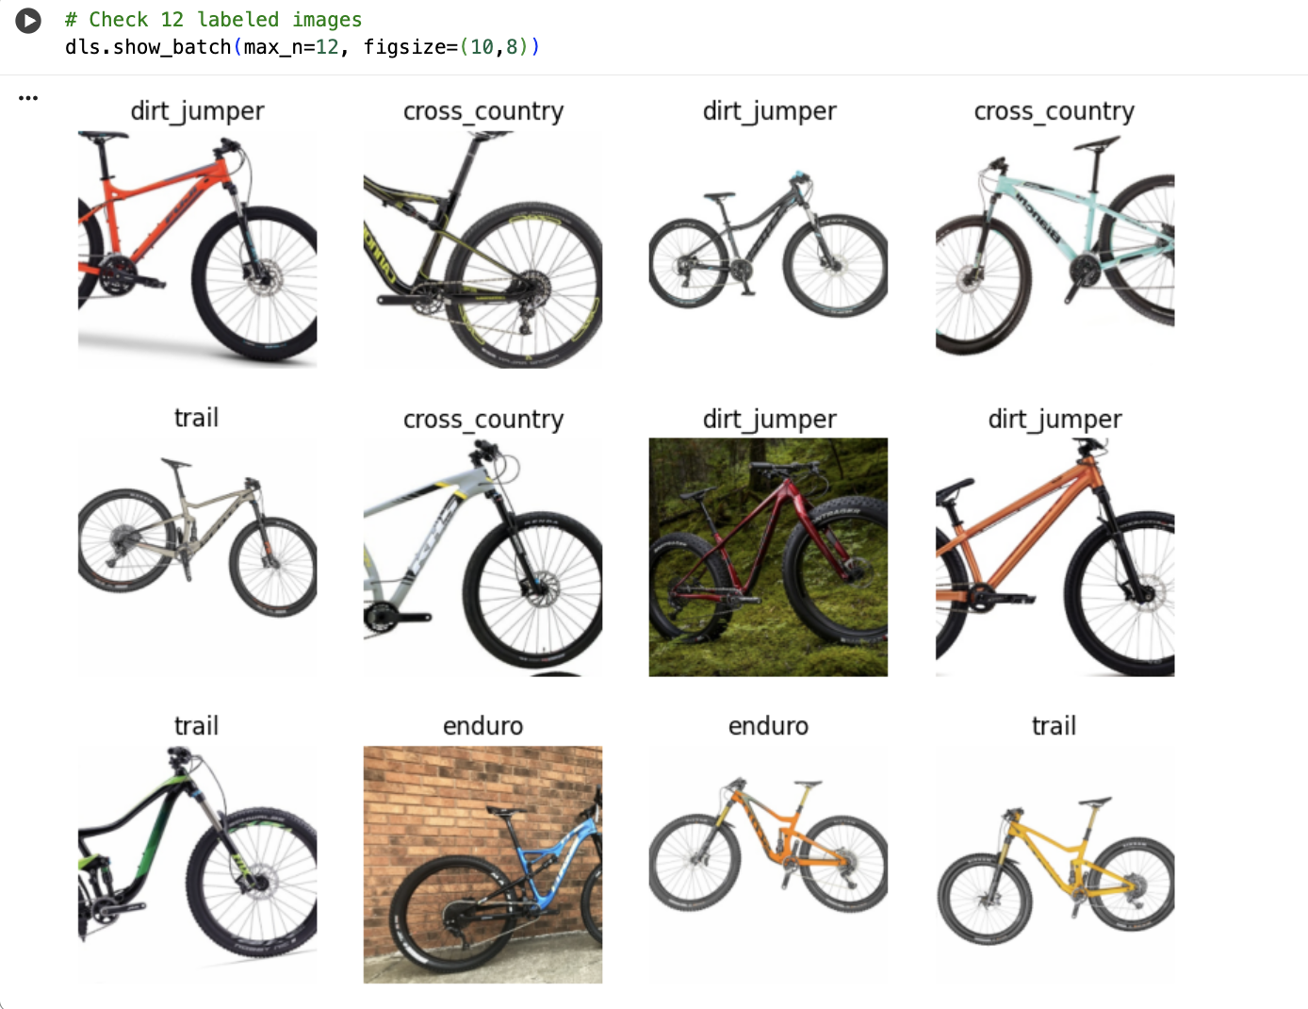
Example Images
Notes:
At this point we have already done a few things:
downloaded the images from their hyperlinks into an actual image folder we can use.
We have also loaded the image data used to train and test the network by first creating a DataBlock using the FastAI pipeline… this helps describe how the data should be loaded, transformed, and what type of task it will be used for in the model.
Our exploratory data analysis consists of examining example images… we did this by using the show_batch() method to show a few images and their labels as seen on the screen…
Through this we were able to verify that the images and labels loaded correctly… and that the dataset includes all categories of riding styles with proper augmentations like rotation and zoom applied to the parts of the bike that are important to see.

Slide 12
Modeling
Epochs Parameters
Confusion Matrix

Slide 13
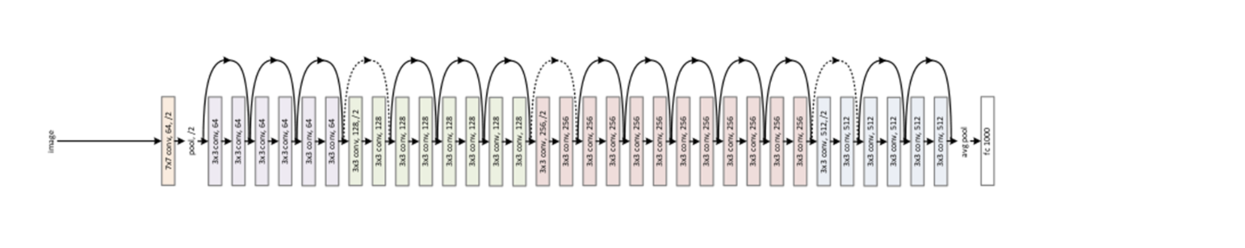
ResNet-34 Modeling
Notes:
We want to develop a classification system that classifies the mountain bike type into the correct riding style.
We will use a deep neural network to build the classification model. Rather than training a network from scratch, we will modify an existing deep neural network to solve the problem of recognizing riding style of bikes.
We trained a model to classify mountain bike riding styles, starting from the resnet34 model that has already been trained to solve an image classification problem involing many types of images.
FastAI's vision_learner makes this very easy to perform.

Slide 14
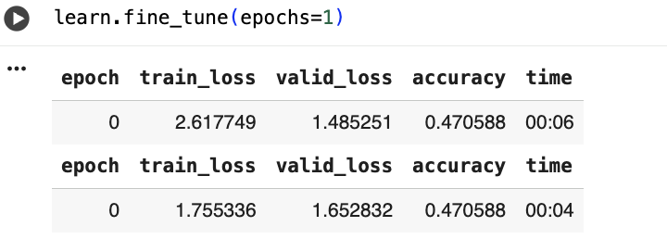
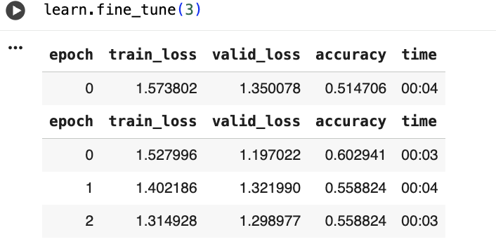
Training & Testing
Notes:
The outputs displayed on this slide is show our training results from FastAI’s learn.fine_tune(), and it gives us insight into how the model is learning….
Column 1 - Epoche - Shows us the current trianings round or pass through the data set.
Column 2 - train_loss - Shows us the how much error the model made on the training data. Lower = better fit
Column 3 - valid_loss - Shows us How much error the model made on the validation data (data it hasn’t seen before). Lower = better generalization.
Column 4 - accuracy - The fraction of validation images correctly classified (0.5 is 50%)
Column 5 - time - shows us How long that epoch took to run.
Analysing these results for our model –
TEST 1
The model starts with moderate loss values (normal for the first epoch).
accuracy = 0.47 → about 47% of validation images are classified correctly after the very first short training phase.
This is a good initial baseline.
TEST 2
Train loss decreases steadily (2.6 → 1.3), showing that the model is learning patterns in our training data.
Validation loss also decreases (1.48 → 1.29), meaning it’s generalizing better to unseen images.
Accuracy improves from 47% → ~56% — that’s a solid improvement after only 3 more runs
After the second run, we can see that the accuracy stabilizes, suggesting that the model is approaching a learning plateau.
In short: our model is learning meaningfully and not overfitting yet.

Slide 15
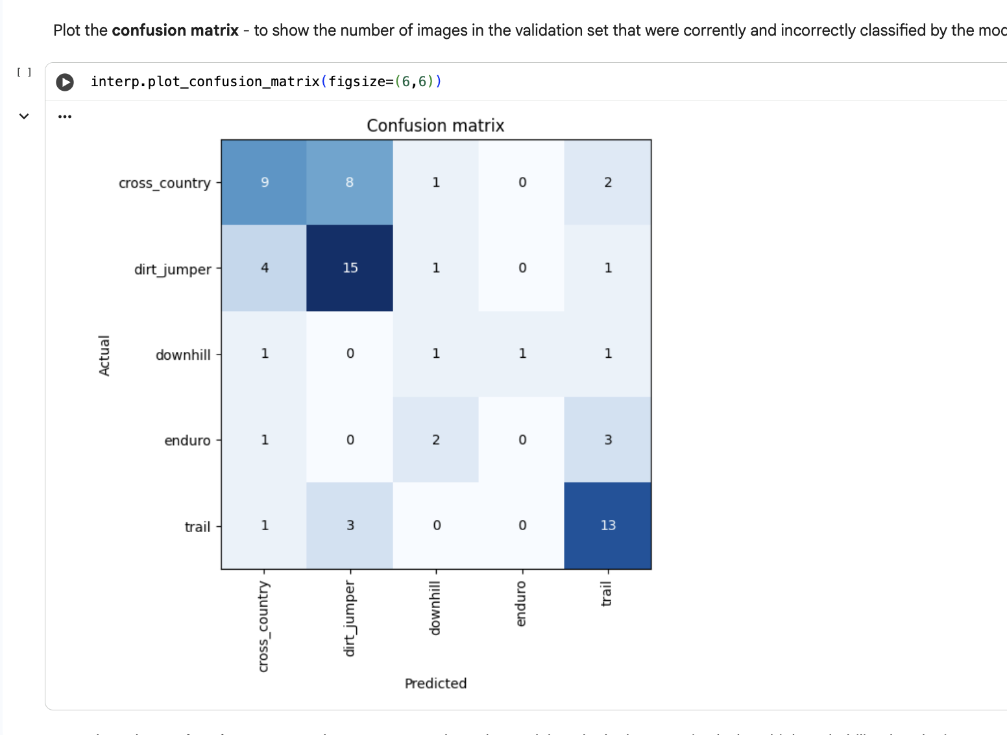
Confusion Matrix
Notes:
To assess performance we uses FastAI's ClassificationInterpretation function to help analyze the performance of the model.
A confusion matrix is one of the most insightful models we can use to analyze performance..
Each row = actual class (the true bike riding style) Each column = predicted class (what our model guessed)
Dark diagonal cells = correct classifications Off-diagonal cells = misclassification
Results ROW BY ROW –
Cross_country – 9 correctly predicted; 8 mislabeled as dirt_jumper; small confusion with downhill and trail.
Dirt_jumper – 15 correctly predicted… this is the strongest performance; only 4 misclassified as cross_country.
Downhill – 1 correctly predicted, some confused with cross_country, enduro, and trail. The moodel seems to struggles due to limited samples or visual similarity.
Enduro – 2 correct, 3 misclassified as trail, 1 as cross_country. This could be due to the fact that enduro and trail bikes often look visually similar due to suspension style.
Trail – 13 correctly predicted — good accuracy; only 3 confused as dirt_jumper.
OVERALL –
dirt_jumper and trail are the easiest for your model to recognize…. Likely because they have distinct frame geometries or color patterns.
downhill and enduro seem to be harder for the model to distinguish between — these bikes share full-suspension designs and are often visually similar.
cross_country also overlaps visually with trail and dirt_jumper.

Slide 16
Evaluation
Deployment
Final Evaluation
Notes:
We can now use the model to predict the bike riding style for an example image and plot the class probabilities.
We will first test the model with one of our own images from our data set.. And then test the model with 4 external images uploaded from outside of our data set…
WE will go over the models prediction… and whether or not we believe the model predicted accurately or not..

Slide 17
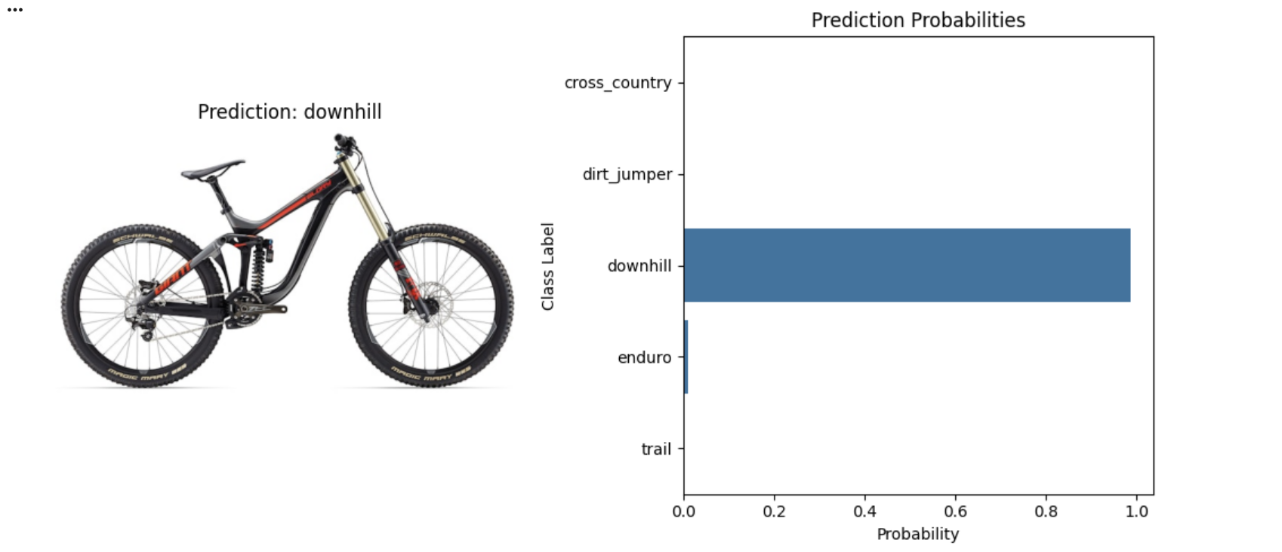
Deployment, First Test
Notes:
The model predicted that the bike in the image is a downhill bike, which is accurate!!
You can see that the model silghly predicts this bike may be an enduro bike... which is a fair analysis based off the geometry of the bike. But overall, the model did very well for this image from our data set.

Slide 18
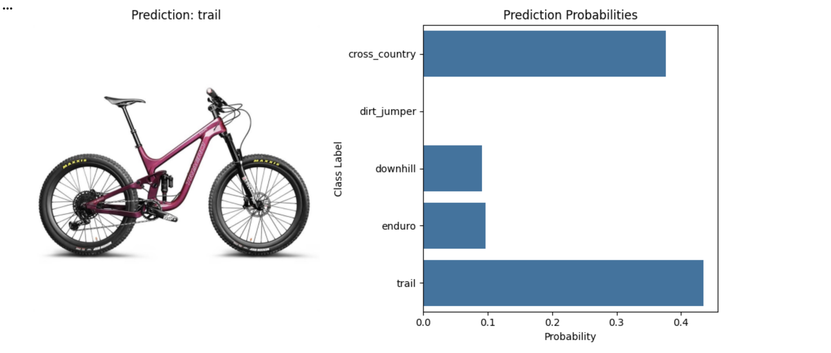
Deployment, Image 1
Notes:
We tested the model with one of our own images from our data set, but we can apply this to other images.
This will be a good way to test how accurate the model's predictions truly are.
NOW before moving onto these extra images.. I want to note that Some of the images used are tough bikes to categorize, even for a human being who knows a lot about bikes.
We will not only be going over how the bike was marketed for sale.. But more importantly… what the actual riding style of the bike is, and if the model predicted that correcntly
For example… looking at this image imported from ICAN Bikes website…
It is a fair analysis that the model put this as both cross_country and trail... because Although this bike is marketed as a “trail” bike.. this is a popular bike used for both cross country and trail riding! There IS a difference between cross country and trail riding in the actual biking community… and bikes can be used interchangeably… so although the model could not seem to categorize this to 1 prediction, that is technically an accurate assumption.

Slide 19
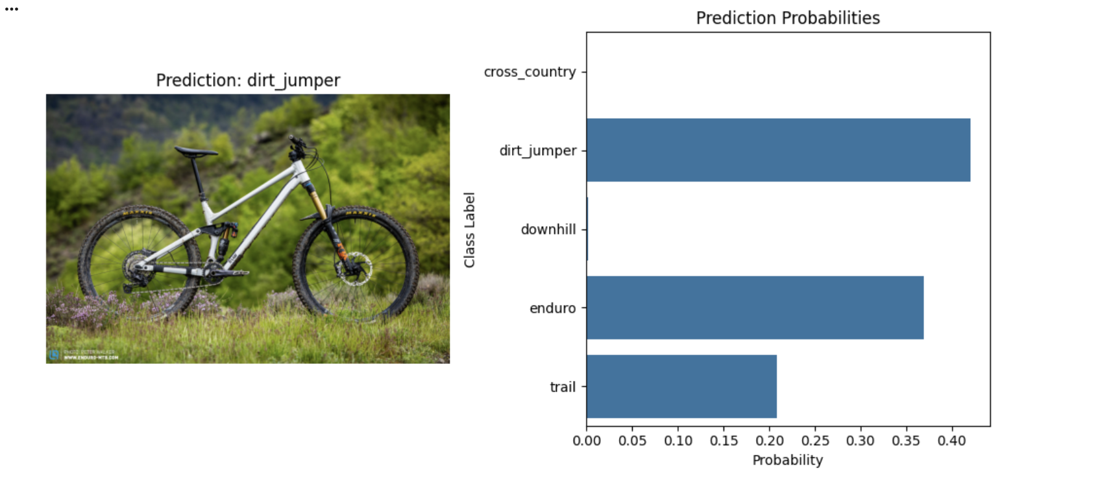
Deployment, Image 2
Notes:
Carrying that same perspective into image 2 here..
altough this bike is marketed as an enduro bike, many riders actually do use this as a dirt_jumper... so again, the models display was actually not "inaccurate" by showing strong predictions in enduro while more heavily in dirt_jumpers…and I am very impressed that it was able to pick up on this.
I believe the model also strongly predicted this to be a trail bike due to its slim geometry, and if I was given this bike in the real world.. To be honest, I would personally use this as a trail bike more than anything.

Slide 20
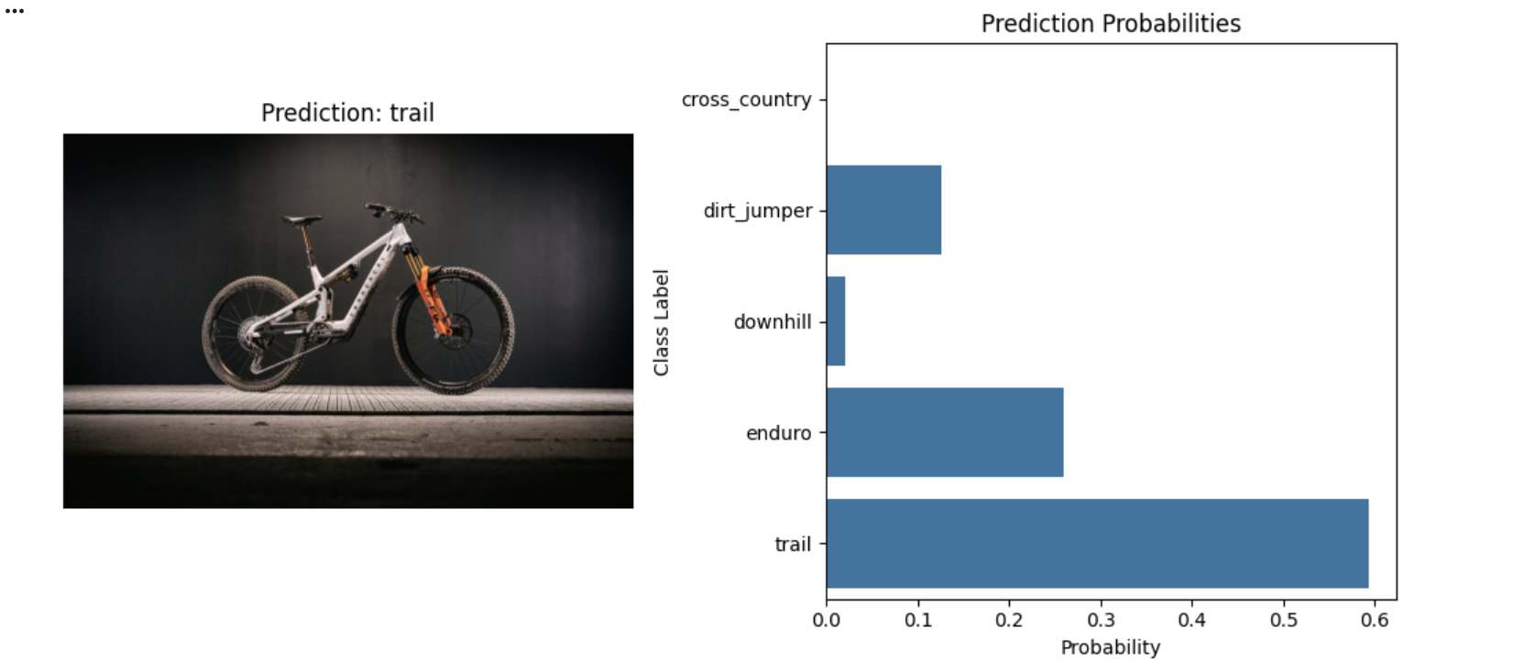
Deployment, Image 3
Notes:
For this bike here marketed as an aeectric and downhill hybrid… I was curious to see the models predictions, especially since ebeike was not a category..
WE can see that the model predicted higher confidence in trail riding style.. and although this is not the same as what the bike is “labeled” as, in a real world scenario, a sane person would never use an ebike for downhill riding… they would use it for trail riding. So this prediction is accurate! The model also displayed some confidence towards enduro riding, which I can see why it would do so because this bikes fork (front suspension) is usually used for enduro bikes. This tells me that the model was able to pick up on these differences while still taking the other details into consideration.

Slide 21
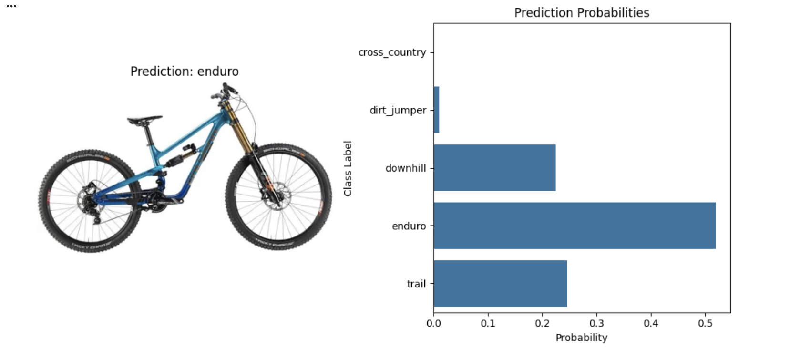
Deployment, Image 4
Notes:
I was excited to use this image as its a very new bike downhill bike on the market.
So new that only a selection of riders have access to it as of now. The model predicted this as an enduro bike, and although that is not how this bike is marketed as, many of the professional riders assigned to test-riding this bike are saying that it rides more like an enduro bike compared to other downhill bikes. So the model, again, did not predict the correct bike type but did predict the riding style accurately!

Slide 22
Final Evaluation
Domain Problem:
We want to develop a model to classify a bike based off of what it can see an image, into one of the following riding styles: Cross Country, Downhill, Enduro, Trail or Dirt Jumper.
Expansions for Improved Accuracy:
I believe the biggest things that could help make the model more accurate would be limiting the image amount for each category.
Notes:
Overall, you can see that there are a lot of characteristics that go into the "riding style" of a bike.... and as you can tell... the way a bike is marketed is not always the type of riding that it is mostly used for. This is why I went back and made that change to the original domain problem as mentioned before
Things like geometry, wheel size, suspension, etc. all makr a difference in the way the bike rides, thus a lot of bike companies are tending to interchange these features to make hybrid-like bikes… and a lot of the time, riders will purchase bikes marketed towards 1 set of riding and use it for a completly different thing.
Based off of the outputs, I do see how the model is classifying these bikes and I believe it did a fantastic job a analyzing these features to predict the riding style of the bike in each image!
I believe the biggest things that could help make the model more accurate would be limiting the image amount for each category to a certain number.
For example, our data folder had majority trail and cross country classifications…
And Since the model seems to lean more biased towards categories that have more images -- having a data folder with equal image amounts for each classification would be ideal.
Thank you for listening!

